Slide 1
CSS342 Data Structures, Algorithms, and Discrete Mathematics (I)

Slide 2
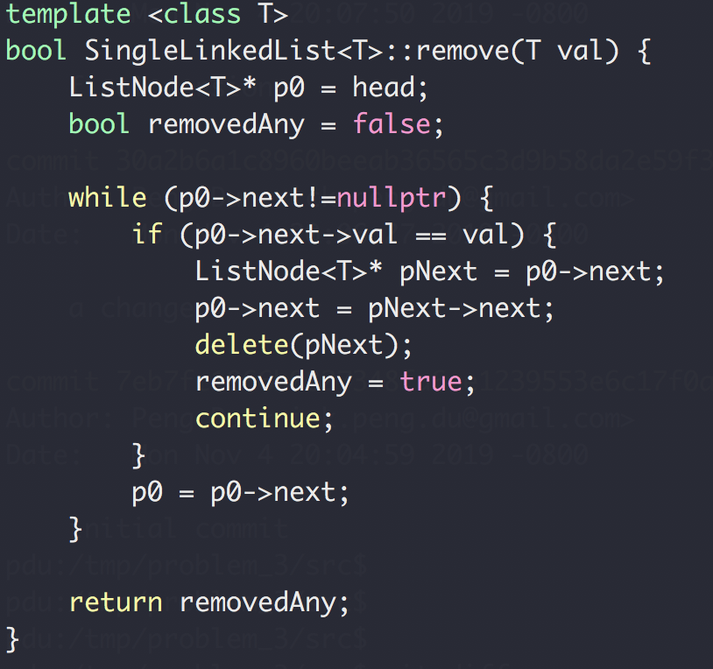
Homework Review
Remove()
head
Next
Next
Next
Next
end

Slide 3
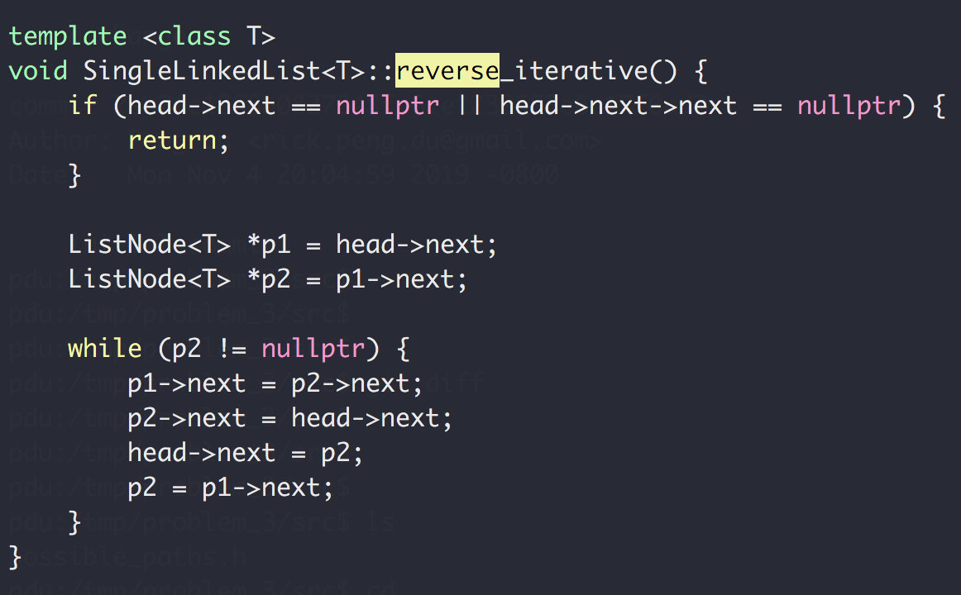
Homework Review
reverse_iterative()
h → 1 → 2 → 3 → 4 → N
h → 2 → 1 → 3 → 4 → N
h → 3 → 2 → 1 → 4 → N
h → 4 → 3 → 2 → 1 → N

Slide 4
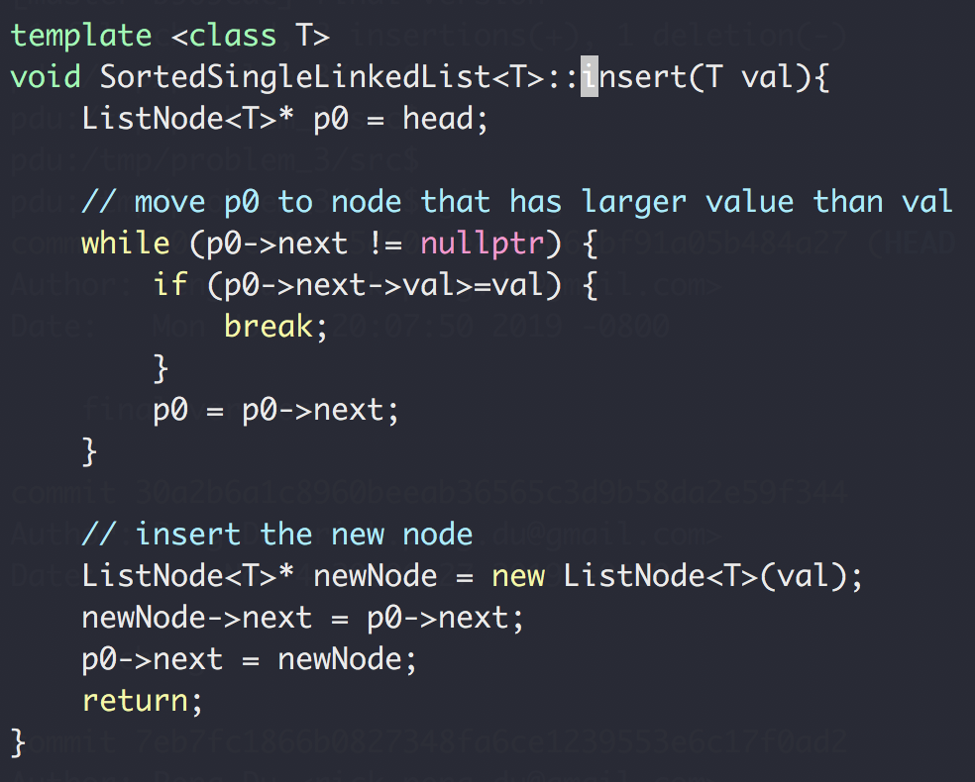
Homework Review
Insert into sorted single linked list
h → 3 → 6 → 9 → N
Insert 5
h → 3 → 5 → 6 → 9 → N

Slide 5
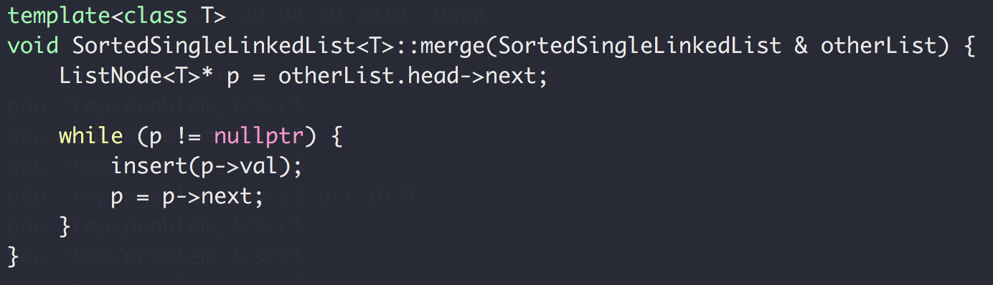
Homework Review
Merge sorted single linked list
h → 3 → 6 → 9 → N
otherList: h → 2 → 5 → 10 → N
h → 2 → 3 → 5 → 6 → 9 → 10 → N

Slide 6
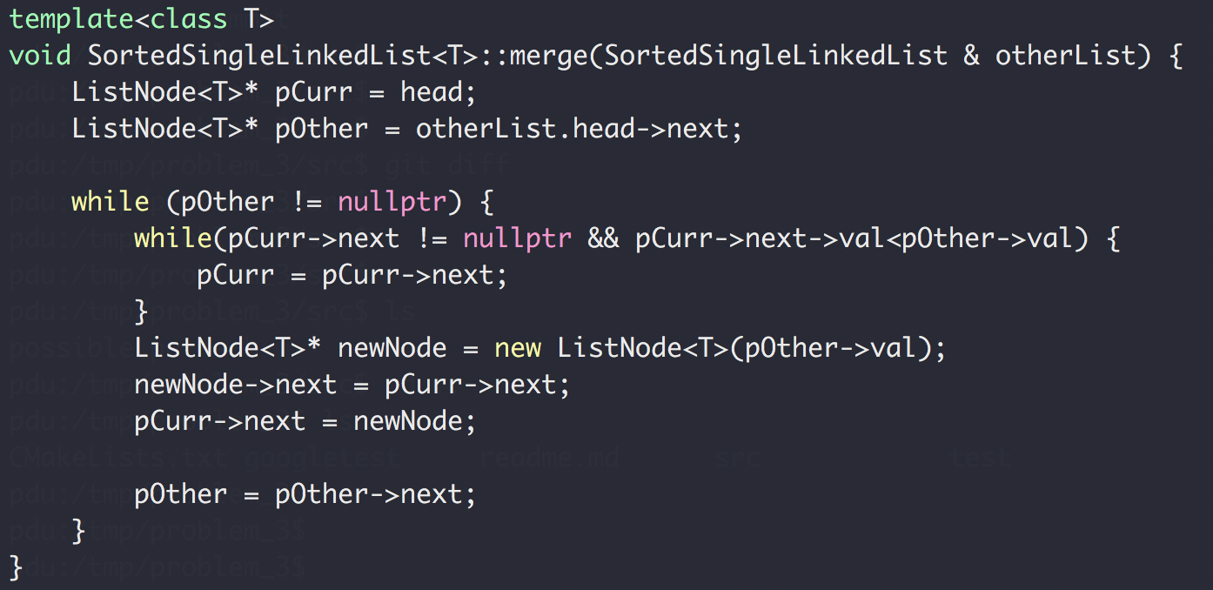
Homework Review
Merge sorted single linked list
h → 3 → 6 → 9 → N
otherList: h → 2 → 5 → 10 → N

Slide 7
A Search Problem
Target: 14
1
3
5
7
9
10
12
12
14
14
18
0
1
2
3
4
5
6
7
8
9
O(log₂N)
log₂10 = 3.322 comparions
worst case scenario

Slide 8
A Search Problem
Target: 14
18
12
1
7
5
10
3
12
9
14
14
0
1
2
3
4
5
6
7
8
9
O(N)
N = 10 comparisons
Worst case scenario

Slide 9
A Search Problem
Can we do better than O(N)?
Option 1: Change the way we solve problems
Option 2: Improve problem condition

Slide 10
A Search Problem
Can we do better than O(N)?
Option 1: Change Algorithm
Option 2: Change Data Structure

Slide 11
A Search Problem
Option 1: Change Algorithm
18
12
1
7
5
10
3
12
9
14
14
0
1
2
3
4
5
6
7
8
9
Sort
O(N²) to O(N log₂N)
1
3
5
7
9
10
12
12
14
14
18
0
1
2
3
4
5
6
7
8
9

Slide 12
A Search Problem
First Sort
Then Search
O(N log₂N)
10 * log₂10 = 33.22 comparisons
O(log₂N)
log₂10 = 3.32 comparisons
Linear search is O(N)
10 comparisons

Slide 13
A Search Problem
And what if we need to add new numbers once in a while
First Sort
Then Search
O(N log₂N)
10 * log₂10 = 33.22 comparisons
O(log₂N)
log₂10 = 3.32 comparisons
Wait! Linear search is O(N)
10 comparisons

Slide 14
A Search Problem
First Sort
Then Search
O(N log₂N)
10 * log₂10 = 33.22 comparisons
O(log₂N)
log₂10 = 3.32 comparisons
Wait! Linear search is O(N)
10 comparisons

Slide 15
A Search Problem
Can we do better than O(N)?
Option 1: Change Algorithm
Option 1: Change Algorithm
Option 2: Change Data Structure

Slide 16
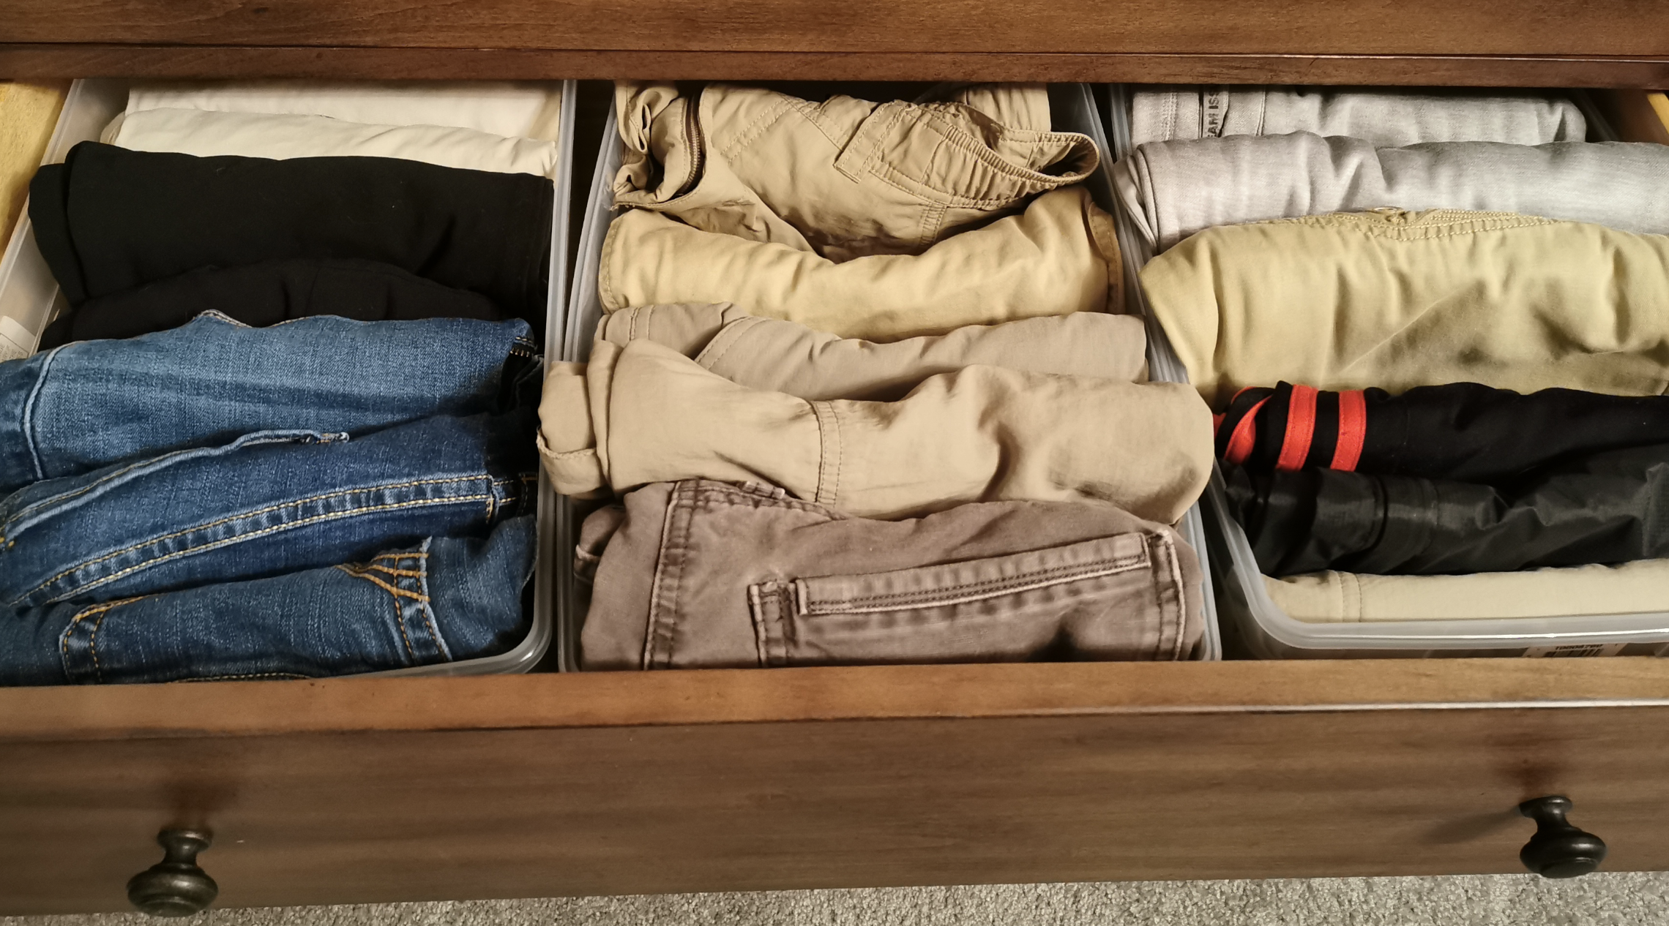

A Search Problem
What if the data is automatically sorted when it’s generated ?

Slide 17
A search problem
data is automatically sorted when it’s generated
18
12
1
7
5
10
3
12
9
14
1
3
5
7
9
10
12
12
14
18

Slide 18
A search problem
data is automatically sorted when it’s generated
13
1
1
3
3
5
5
7
7
9
9
10
10
12
12
12
12
14
13
18
14
18
When there’s data, insert it into the sorted place
When search, use binary search
O(log₂N) with shuffling
O(log₂N) with shuffling
O(log₂N)

Slide 19
A search problem
Array → Shuffling
What about other data structure instead?
1
3
5
7
9
10
12
12
14
18
0
1
2
3
4
5
6
7
8
9
1
1
3
3
5
5
9
9
10
10
12
12
18
12
18
7
12
7
14
14

Slide 20
A search problem
Array → Shuffling
What about other data structure instead?
1
3
3
5
7
9
9
10
12
12
12
14
18
0
1
2
3
4
5
6
7
8
9
3
9
12
9
3
12
1
5
10
14
7
12
18

Slide 21
A search problem
13
9
9
13
3
12
13
1
5
10
14
13
7
12
18
13
13
When there’s data, insert it into the sorted place
When search, binary search traverse the tree
O(log₂N) with shuffling
O(log₂N)

Slide 22
A search problem
Target: 14
?
9
9
?
3
12
1
5
10
14
?
14
7
12
18
Binary Search
Tree

Slide 23
Binary Search Tree
A Binary Search Tree (BST) is a tree in which all the nodes follow the below-mentioned properties:
The left sub-tree of a node has a key less than or equal to its parent node's key.
The right sub-tree of a node has a key greater than to its parent node's key.

Slide 24
Exercise
Is this a binary search tree?
3
1
5
7

Slide 25
Exercise
Is this a binary search tree?
8
3
10
14
1
6
4
7

Slide 26
Exercise
Is this a binary search tree?
8
3
10
14
5
6
4
7

Slide 27
Exercise
Is this a binary search tree?
8
3
10
2
14
1
6
4
7

Slide 28
Exercise
Is this a binary search tree?
2
3
5
7
9

Slide 29
A Search problem
Sorted array → binary search
Random array
Sort first, and then binary search
Keep data always sorted when creating the data
Array → data shuffling
Linked list?
Binary tree

Slide 30
Kinds of Trees
Binary Search Tree
Fast search
Fast insert
Binary Tree

Slide 31
Binary Tree Definition
9
9
Parent
12
3
12
1
5
Child
5
10
10
14
Parent
7
12
18
7
Child

Slide 32
Binary Tree Definition
Root
9
9
9
3
12
1
5
1
5
10
14
7
12
12
18
7
18
Leaf

Slide 33
Binary Tree Definition
3
1
5
7
Height of a tree:
Number of nodes
on the longest path
from root to leaf
5
Height = 4
3
3
3
9
1
5
1
1
5
7
Height = 3
Height = 1
Height = 2
Height = 2

Slide 34
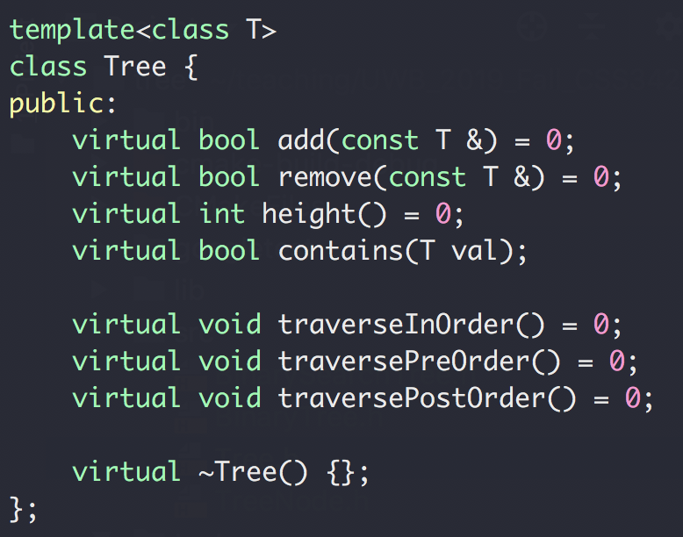
Tree ADT
Interface

Slide 35
Tree ADT
Implementation
Data storage:
Array vs List (of nodes)

Slide 36
Tree ADT
3
1
5
Implementation
Data storage:
Array
List
7
3
1
5
2
7
8
3
1
5
2
7
8
0
1
2
3
4
5
6
“heap ➔ priority queue

Slide 37
Tree Node
Implementation
Data storage:
Array
List
3
1
5
7
Left
Right
Next

Slide 38
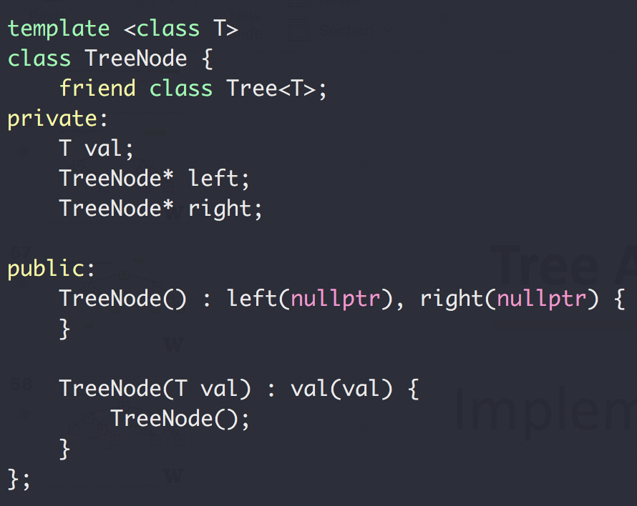
Tree Node
Implementation
Data storage:
Array
List
TreeNode
Left
Right

Slide 39
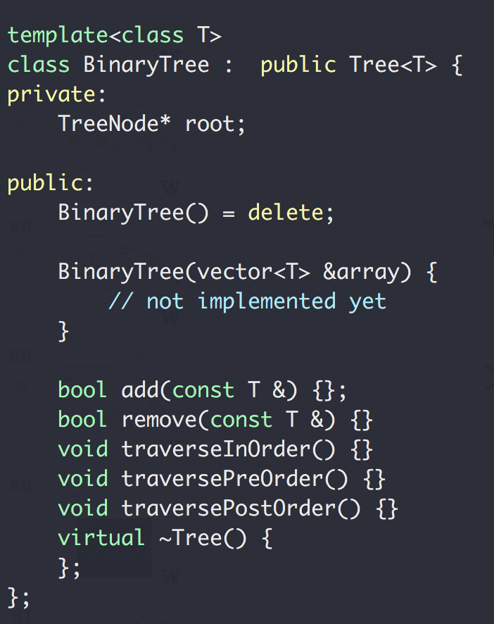
Tree ADT
Implementation
Data storage:
Array
List

Slide 40
Binary Tree
Given a binary tree, how to get the height?
3
1
5
7
5
Height = 4

Slide 41
Tree Traversal
How many nodes in a tree?
Given a binary tree, how to traverse the node?
Destructor

Slide 42
Binary Tree Traversal
Pre-order: root, left, right
3
1
1
5
2
7
2
7
8
1, 2, 7
3, 1, 2, 7, 5, 8

Slide 43
Binary Tree Traversal
In-order: left, root, right
3
1
1
5
2
7
2
7
8
2, 1, 7
2, 1, 7, 3, 8, 5

Slide 44
Binary Tree Traversal
Post-order: left, right, root
3
1
1
5
2
7
2
7
8
2, 7, 1
2, 7, 1, 8, 5, 3

